Slide 1

03 Seven Segments
ST151
Bayu Setiaji, M.Kom

Slide 2
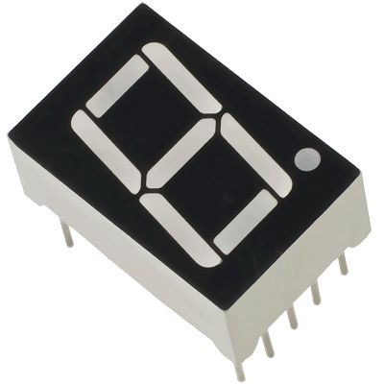
Outline Materi
Jenis seven segments
Cara kerja seven segments
Contoh

Slide 3
Pengenalan

Slide 4
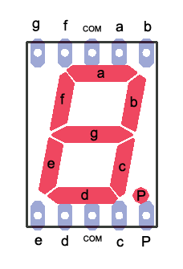
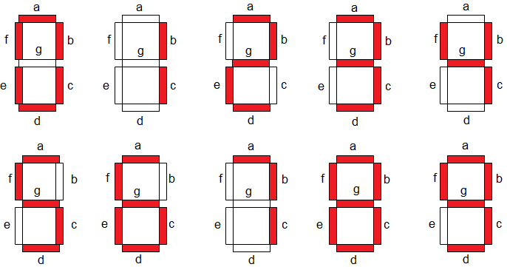
Seven Segments

Slide 5
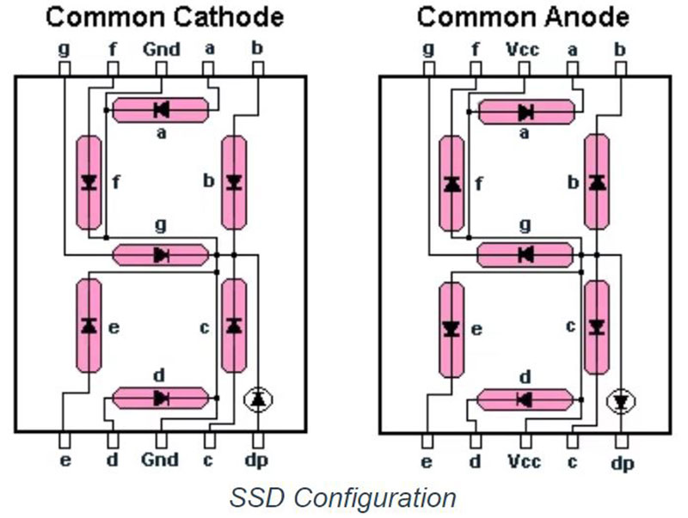
Jenis Seven Segments
Common Cathode
Semua GND terhubung menjadi 1
HIGH = menyala
Common Anode
Semua VCC terhubung menjadi 1
LOW = menyala

Slide 6
Contoh

Slide 7
Contoh
Angka 2
Segment: a – b – g – e – d
 | a | b | c | d | e | f | g | dp
Com Anode | LOW | LOW | HIGH | LOW | LOW | HIGH | LOW | HIGH
Com Cathode | HIGH | HIGH | LOW | HIGH | HIGH | LOW | HIGH | LOW

Slide 8
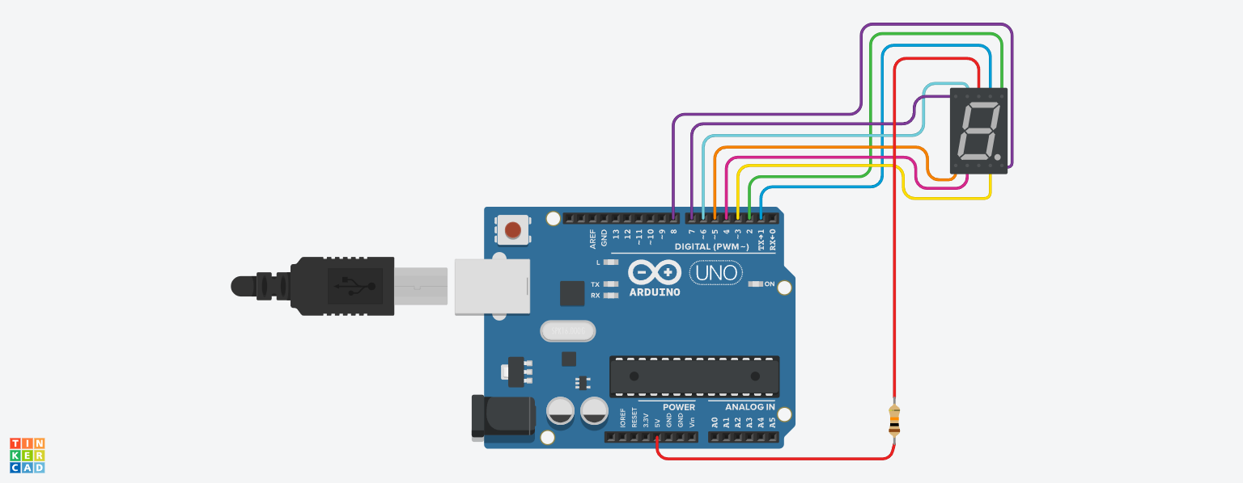
Contoh (Common Anode)

Slide 9
Kode
Common Anode
// segmen a b c d e f g dp
// pin 1 2 3 4 5 6 7 8
void setup() {
// set semua pin ke OUTPUT
for(int i = 1; i <= 8; ++i)
pinMode(i, OUTPUT);
}
void loop() {
// menampilkan angka 2
// segment: a b d e g
digitalWrite(1, LOW);
digitalWrite(2, LOW);
digitalWrite(3, HIGH);
digitalWrite(4, LOW);
digitalWrite(5, LOW);
digitalWrite(6, HIGH);
digitalWrite(7, LOW);
digitalWrite(8, HIGH);
delay(1000);
}
Percobaan
Ubahlah rangkaian menggunakan coomon cathode
Tampilkan digit yang lain

Slide 10
Skema TinkerCad:
https://www.tinkercad.com/things/jNa5uyYsSPx-seven-segments-com-anode?sharecode=S1YI_MvakFAPsNvIu-xGfLyQWn6Vgmk-6VrNt6t2yMU&authuser=0

