Slide 1
02 Game: sekilas
ST166-S1IF
Proyek Game
bayusetiaji@amikom.ac.id | 2025

Slide 2
Sejarah
bayusetiaji@amikom.ac.id | 2019

Slide 3

PONG
Atari Inc., 1972
https://en.wikipedia.org/wiki/Pong
bayusetiaji@amikom.ac.id | 2019

Slide 4

Tomb Raider
1996 - …
https://en.wikipedia.org/wiki/Pong
http://i.ytimg.com/vi/vRvclH7tRvk/hqdefault.jpg
bayusetiaji@amikom.ac.id | 2019

Slide 5
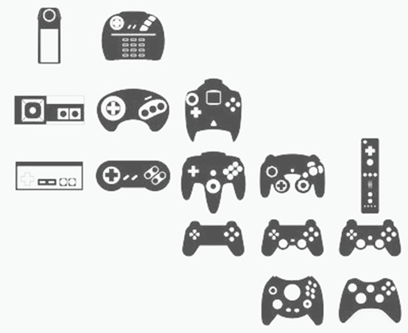
http://kcgd.info/wp-content/uploads/2013/11/history-of-gaming.jpg
bayusetiaji@amikom.ac.id | 2019

Slide 6

http://cdn2-www.craveonline.com/assets/uploads/2014/11/VideoGameGraphics.jpg
bayusetiaji@amikom.ac.id | 2019

Slide 7
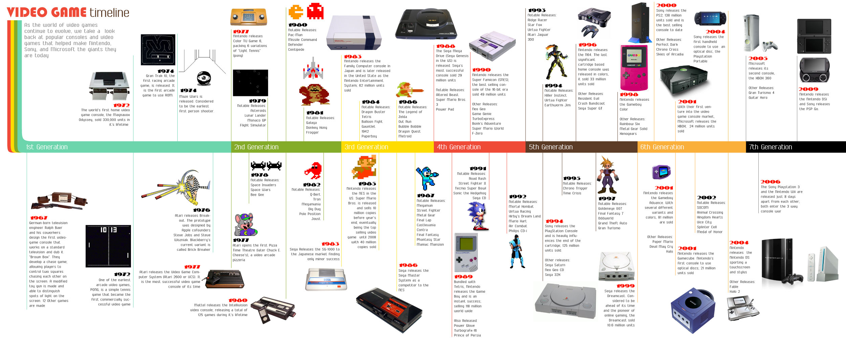
http://www.onlineeducation.net/videogame_timeline/video-game-timeline.jpg
https://www.gamesmen.com.au/media/wysiwyg/retro-video/australian-video-game-timeline.jpg
bayusetiaji@amikom.ac.id | 2019

Slide 8
Genre
bayusetiaji@amikom.ac.id | 2019

Slide 9










Game
Puzzle
Sport
Fighting
Platformer
Strategy
FPS
Simulation
Action
Beat ‘em All
Racing
bayusetiaji@amikom.ac.id | 2019

Slide 10
Rating
bayusetiaji@amikom.ac.id | 2019

Slide 11
A video game content rating system is a system used for the classification of video games into suitability-related groups
-Wikipedia
bayusetiaji@amikom.ac.id | 2019

Slide 12
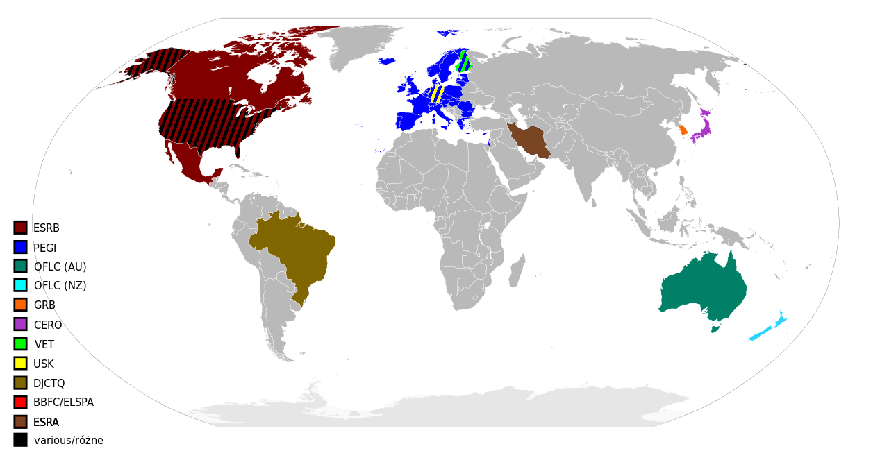
By Selecting and filling of the countries: Holek (talk · contribs) - based on Image:BlankMap-World6.svg, CC BY-SA 2.5 pl, https://commons.wikimedia.org/w/index.php?curid=2108433
bayusetiaji@amikom.ac.id | 2019

Slide 13
Indonesia?
bayusetiaji@amikom.ac.id | 2019

Slide 14
IGRS
IGRS (Indonesian Game Rating System) atau Klasifikasi Permainan Interaktif Elektronik. IGRS merupakan implemetasi peraturan Menteri Komunikasi dan Informatika Republik Indonesia nomor 11 tahun 2016 tentang Klasifikasi Permainan Interaktif Elektronik.
https://igrs.id/tentang
Indonesian Game Rating System (IGRS) is an official video game content rating system founded and set by the Indonesian Ministry of Communication and Informatics in 2016. IGRS rates games that are developed and/or published in Indonesia.
https://en.wikipedia.org/wiki/Video_game_content_rating_system#Indonesia
bayusetiaji@amikom.ac.id | 2019

Slide 15





IGRS Classifications (age)
age 3 or over,
usia 3 tahun atau lebih,
age 18 or over,
usia 18 tahun atau lebih,
age 7 or over,
usia 7 tahun atau lebih,
for all ages.
“Semua Usia”,
age 13 or over,
usia 13 tahun atau lebih,
bayusetiaji@amikom.ac.id | 2019

Slide 16
IGRS Classifications (content)
3+ No restricted content is shown including adult content, use of drugs, gambling simulation, and online interactions.
7+ No restricted content is shown including adult content, use of drugs, gambling simulation, and online interactions.
13+ Restricted contents are partially shown, including light use of drugs and alcohol by figures/background characters, cartoon violence, mild language, gambling simulation, horror theme, and online interactions.
18+ Restricted contents are mostly shown, if not all, including use of drugs and alcohol by main characters, realistic violence (blood, gore, mutilation, etc.), crude humor, gambling simulation, horror theme, and online interactions.
SU Playable for all ages.
https://en.wikipedia.org/wiki/Video_game_content_rating_system#Indonesia
bayusetiaji@amikom.ac.id | 2019

Slide 17
References
https://en.wikipedia.org/wiki/Video_game_content_rating_system
http://www.esrb.org/ratings/ratings_guide.jsp#rating_categories
https://igrs.id
bayusetiaji@amikom.ac.id | 2019

Slide 18
Peluang
bayusetiaji@amikom.ac.id | 2019

Slide 19
$ 50.000
/ hari
bayusetiaji@amikom.ac.id | 2019

Slide 20

Flappy Bird
24 Mei 2013 – 10 Februari 2014
In-app advertisement
$50k / day
Source: http://en.wikipedia.org/wiki/Flappy_Bird
bayusetiaji@amikom.ac.id | 2019

Slide 21
Rantai Industri
Capital - Publishing
Product - Talent
Production - Tools
Distribution
Hardware
User
(Ben Sawyer - DigitalMill)
bayusetiaji@amikom.ac.id | 2019

Slide 22
Model Bisnis(Mobile)
In-app advertising
In-app purchasing
Pay per download
Sponsorship
…
bayusetiaji@amikom.ac.id | 2019

Slide 23
any question?

