Slide 1
04 Game Design Document
ST166-S1IF
Proyek Game
bayusetiaji@amikom.ac.id | 2025

Slide 2
Development Process
bayusetiaji@amikom.ac.id | 2019

Slide 3
Concept
Prototype
Implementation
programming, art production
Test
Release
Design
Pre-production
Production
Post-production
Pitch
Designer
Programmer
Programmer
Artist
Tester
bayusetiaji@amikom.ac.id | 2019

Slide 4



Graphic
Animation
Sound FX
Story
Gameplay
Art Style
Artist
Logic
AI
Physic
Game
Designer
GDD
Programmer
bayusetiaji@amikom.ac.id | 2019

Slide 5
Game Design Document Overview
bayusetiaji@amikom.ac.id | 2019

Slide 6
A game design document (GDD) is a highly descriptive living design document of the design for a video game, created and edited by the development team as result of collaboration between designers, artists and programmers as a guiding vision which is used throughout the game development process, used to organize efforts within development team. It is often attached to the agreement between publisher and developer. -Wikipedia
bayusetiaji@amikom.ac.id | 2019

Slide 7
image
text
diagram
Unstandardized Format
concept art
bayusetiaji@amikom.ac.id | 2019

Slide 8
Structure
Story
Level
Environment
Art Style
Sound & Music
User Interface
Gameplay
Control
…
bayusetiaji@amikom.ac.id | 2019

Slide 9
Common Mistakes
Describing everything at once
Not setting deadlines
Assuming every one knows what to add
Printing the doc
bayusetiaji@amikom.ac.id | 2019

Slide 10
Examples
Template
bayusetiaji@amikom.ac.id | 2019

Slide 11
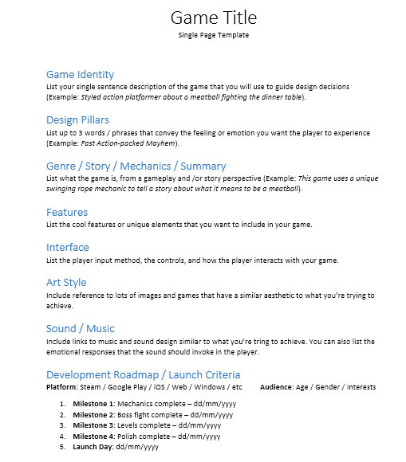
bayusetiaji@amikom.ac.id | 2019

Slide 12
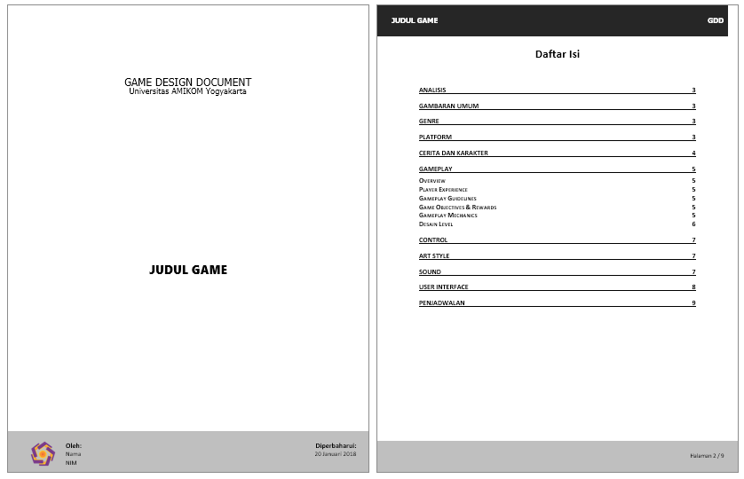
bayusetiaji@amikom.ac.id | 2019

Slide 13
References
http://gamedevelopment.tutsplus.com/articles/how-and-why-to-write-a-great-game-design-document--cms-23545
http://www.gamasutra.com/view/feature/131632/creating_a_great_design_document.php
https://www.youtube.com/watch?v=q96lz725gIw
bayusetiaji@amikom.ac.id | 2019

